Slide 1
FairTraj-COSMOS:
Train-Rich, Eval-Pure Missingness Protocols for Calibration-Robust Trajectory Prediction
Student(s) names: Wangshu Zhu
Student(s) UNIs: wz2708
Date: 8/14/2025
ZKLab, Prof. Zoran Kostic, Columbia University

Slide 2
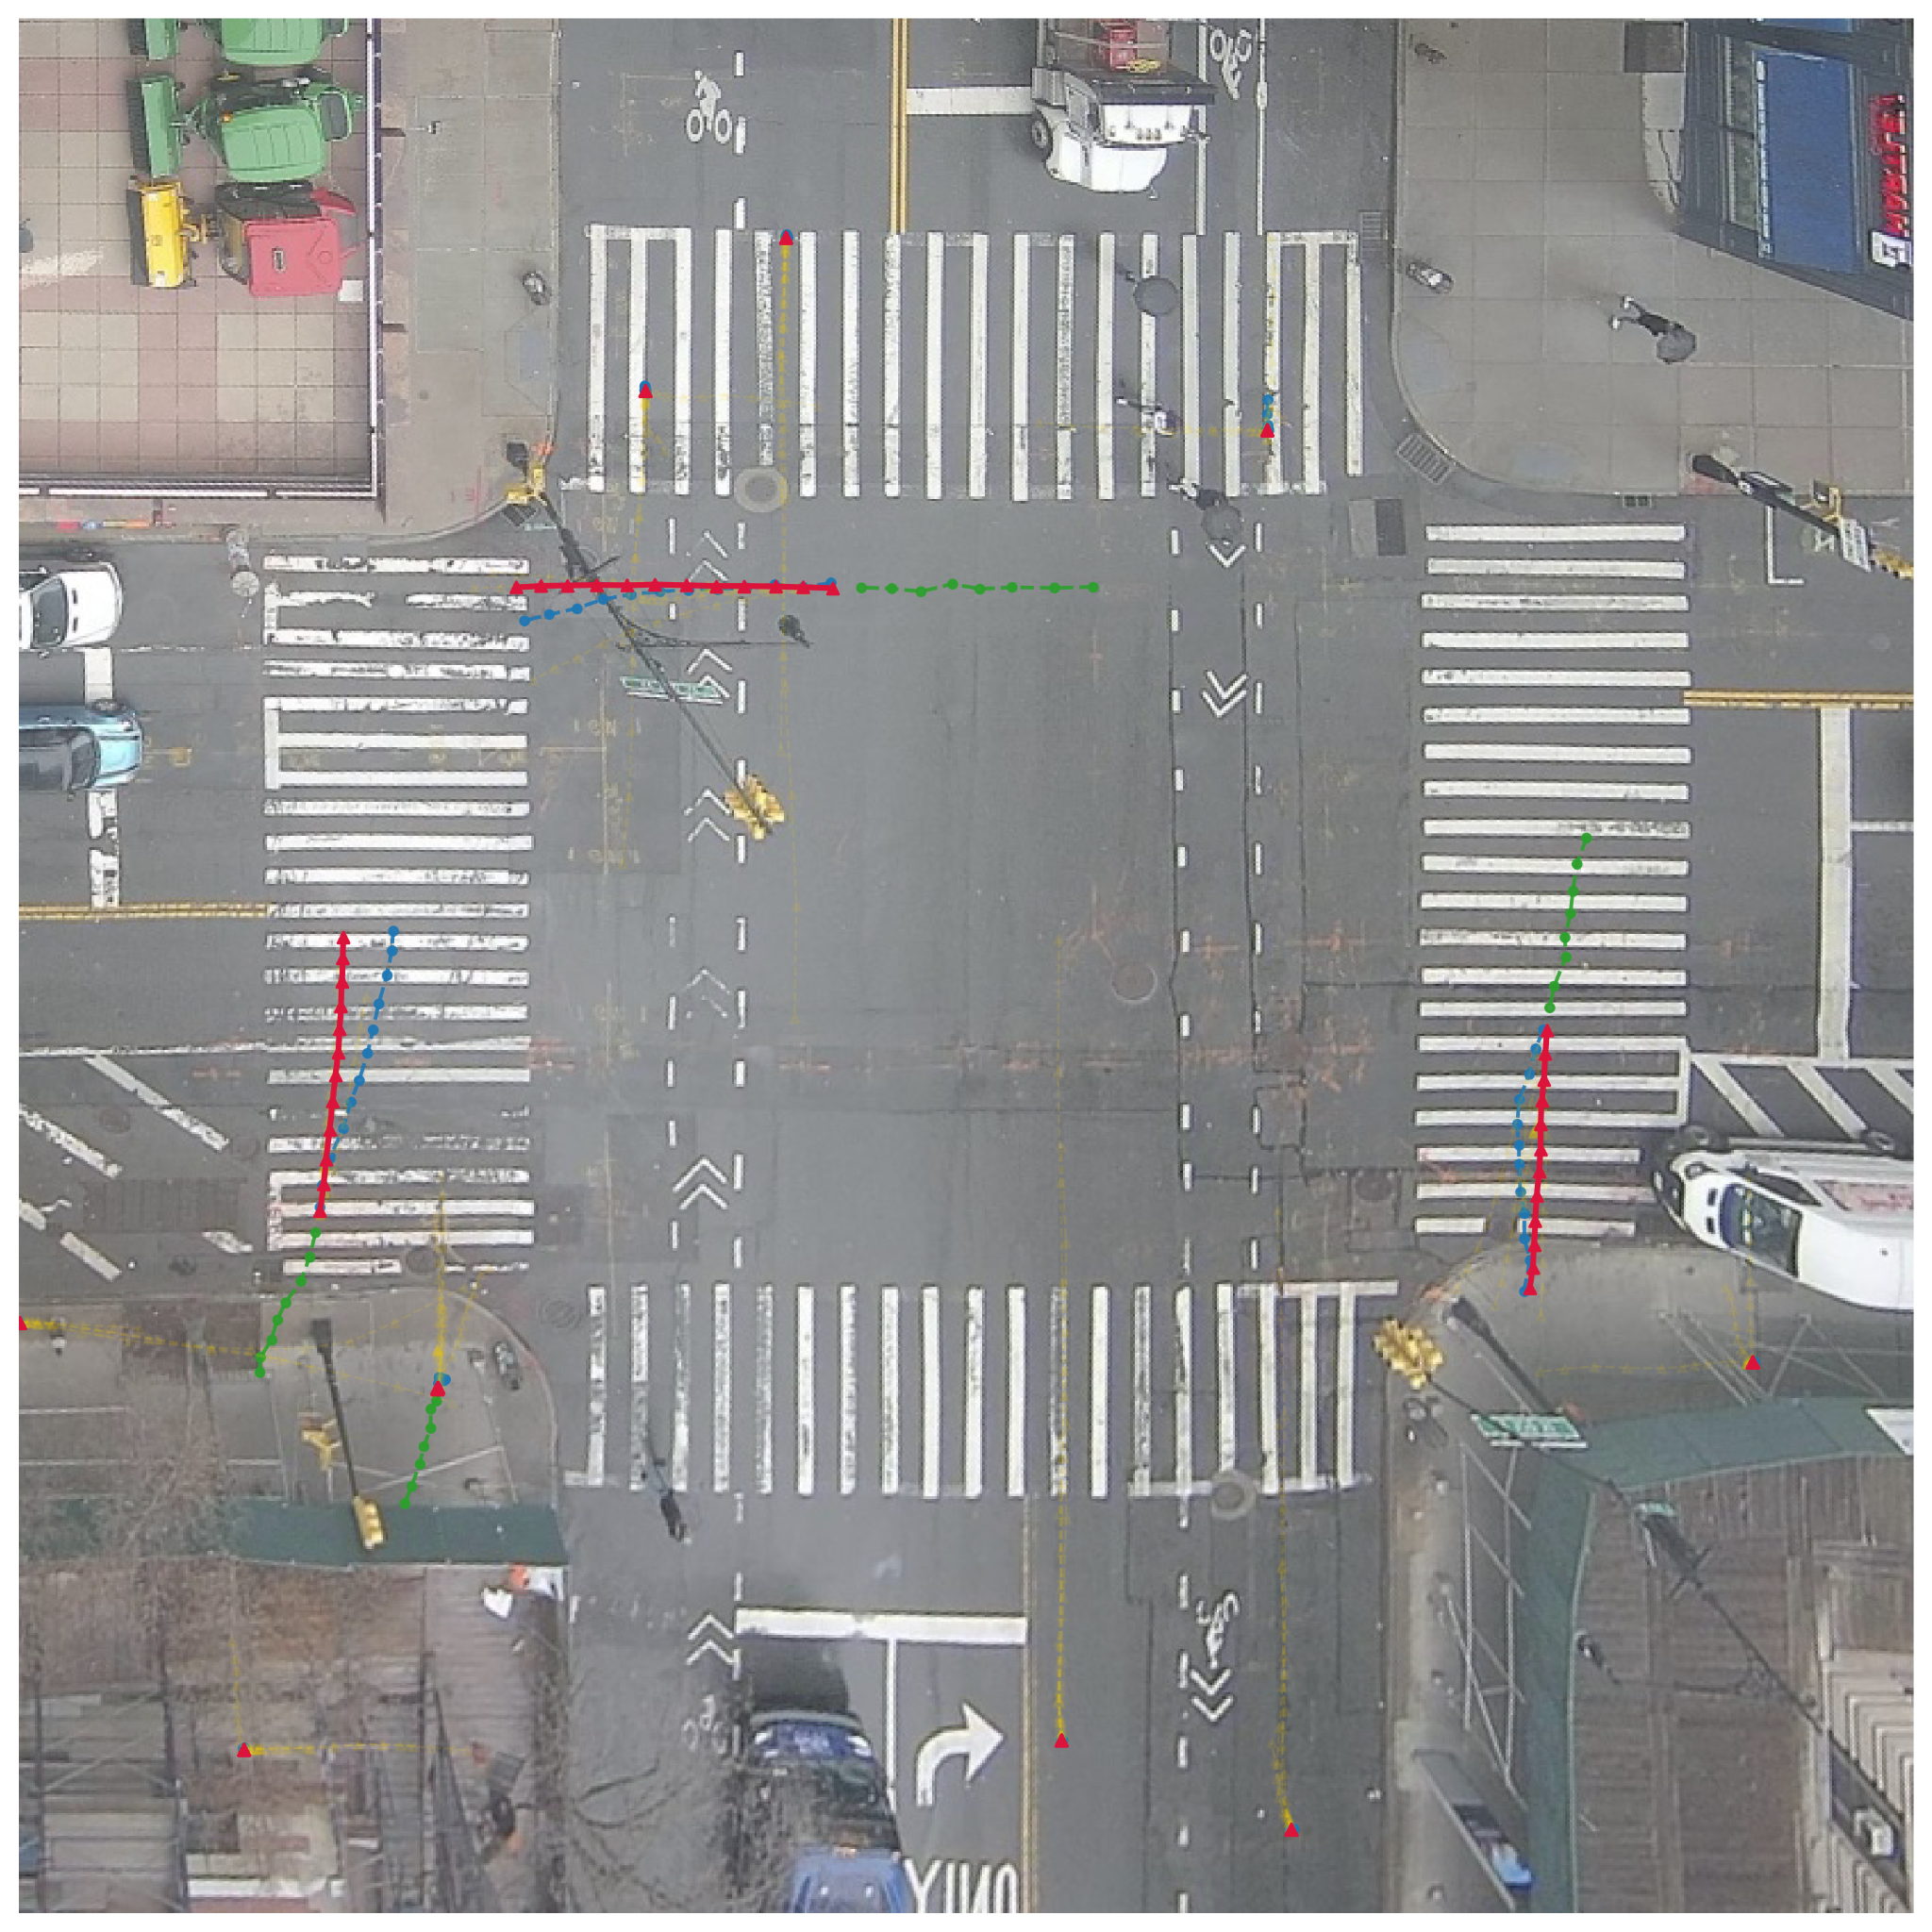
Outline of the Presentation
Key Links
Backgrounds
Our Approach
Data Protocols
Unitraj Architecture
Experimental Results
Further Research
References

Slide 3
Key Links
Report: Research.Traffic.wz2708.FairTraj.report.docx
Github: https://github.com/zk2172-columbia/UniTraj.git
Data: traffic2025
Google slides: research.traffic.wz2708.FairTraj.slides.pptx
log file: Research.Traffic.wz2708.traffic.log.docx
Computing environment: cosmos_bed srv4-lg1 V100 16G
Machine image: Ubuntu 24.04.2 LTS + CUDA 12.8 + PyTorch 2.5.0

Slide 4
Backgrounds – Trajectory prediction
Trajectory prediction:
Sequence of future positions of an agent over time.
Typically represented as (x,y,t) in spatial-temporal coordinates.
Applications:
Autonomous driving (collision avoidance, path planning).
Pedestrian flow prediction (smart cities, crowd simulation).
Robotics (human–robot interaction).
Challenges:
Multi-modality: Many possible futures, not just one deterministic outcome.
Agent heterogeneity: Cars, bikes, pedestrians move differently
Complex environments: Road topology, traffic lights, crosswalks, lanes.

Slide 5
Backgrounds – Real Trajectory Datasets are Messy
Real world trajectory dataset contain missingness:
dropped frames
short tracks
early exits
async frame rates
Common fixing methods:
strict filtering
interpolation/extrapolation
filled but masked
zero-fill with masks
Due to inconsistent treatment, reported metrics are often not comparable

Slide 6
Backgrounds – Missingness Changes Leaderboard
Metric coupling:
interpolation smooths targets → lower ADE/FDE
filtering removes hard cases → lower miss rate
Protocol bias:
model trained on one training dataset can achieve better results on that specific testing dataset
Calibration risk:
model trained on filled labels can be overconfident
reliability may degrade when deploying on real world
Without a standardized missingness protocol, conclusions can reverse

Slide 7
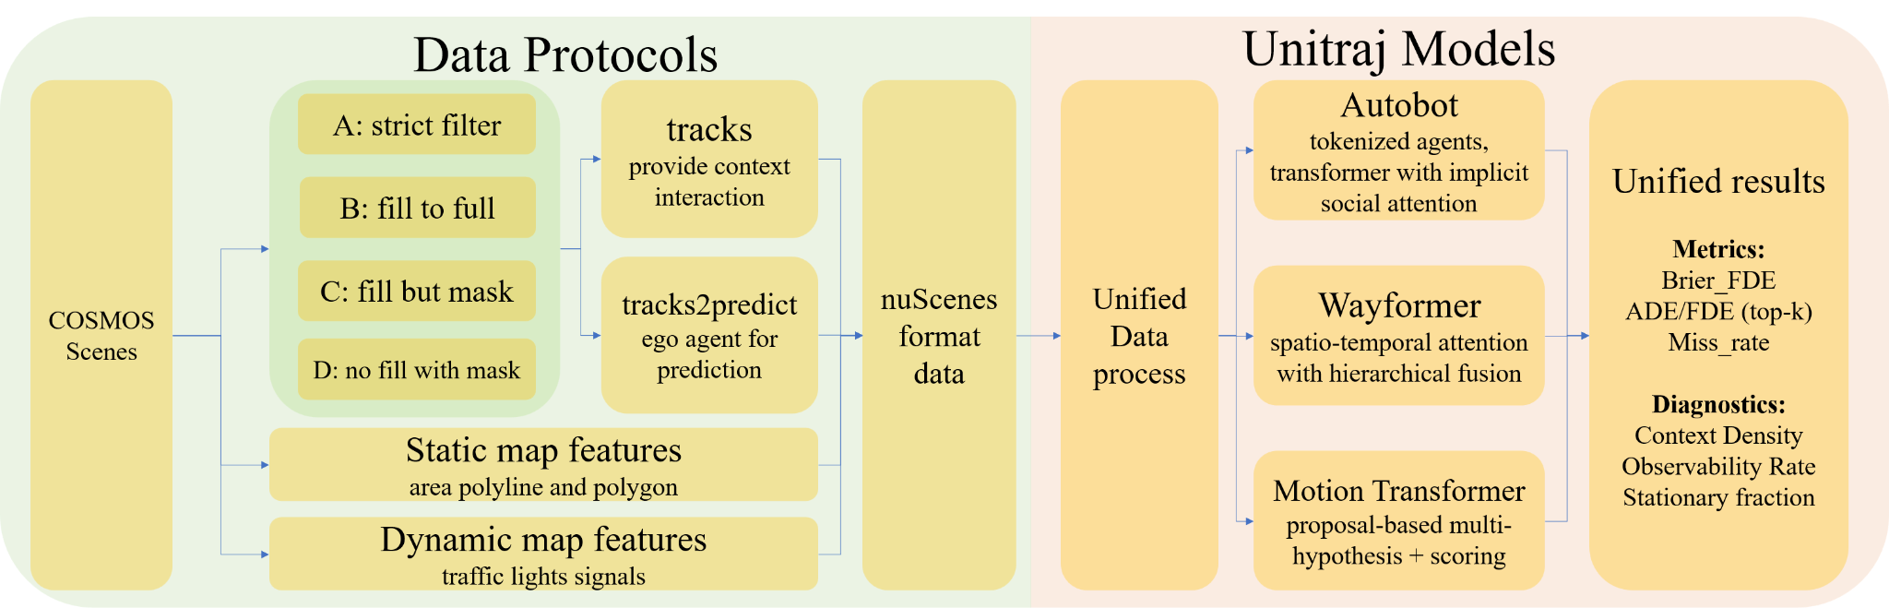
Our Approach: FairTraj-COSMOS
1. Unified conversion adapter: COSMOS dataset → nuScenes-style scenarios
2. Four missingness protocols: A: strict filtering; B: fill+valid; C: fill+mask; D: zero-fill+mask.
3. Standardized UniTraj: AutoBot, Wayformer, MTR; same budgets & seeds; mask-aware loss
4. Evaluation & diagnostics: ADE/FDE/top-k, Miss, Brier-FDE;

Slide 8
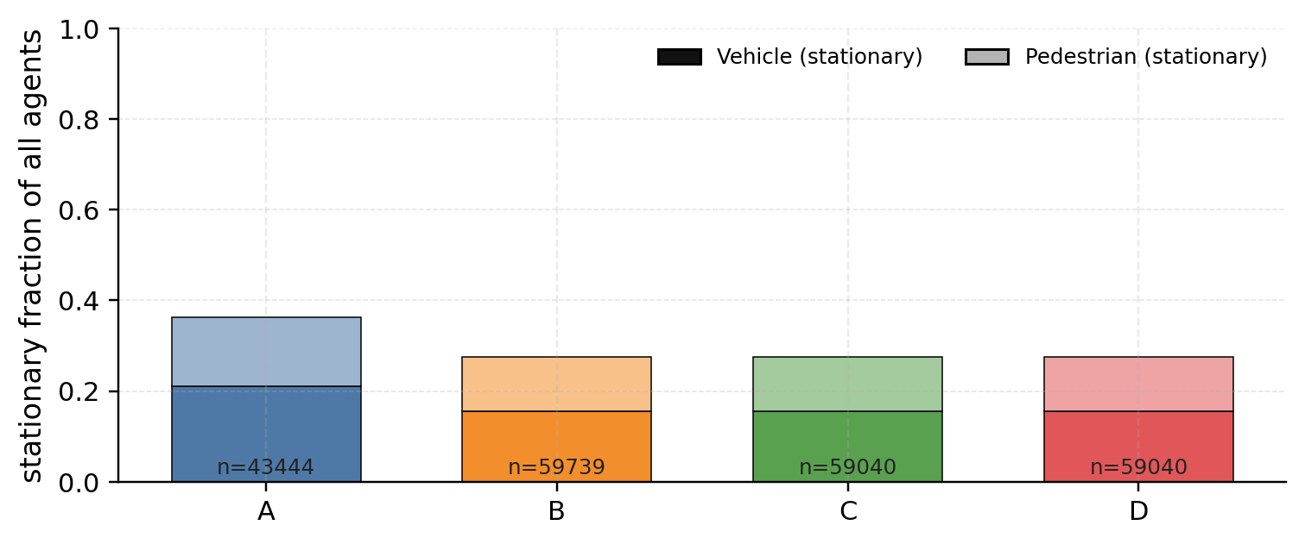
Data Protocols – Data Diagnostics
Policy | Filter short | Fill to 20 | Mask filled | What it changes to the data
A Strict filter | ✅ | ✖ | – | Lowest context density, highest stationary, targets all real.
B Fill–treat-as-real | ✖ | ✅ | ✖ | Densest scenes, smooth trajectories; optimistic test.
C Fill–mask | ✖ | ✅ | ✅ | Rich context, pure targets; keeps missingness semantics.
D No fill–mask | ✖ | ✖ | ✅ | Most ‘raw’ missingness; less contextual information
Protocol choice shifts scene distributions
1. Stationary composition in context
A has the largest stationary share (veh↑, ped↑)
B reduces stationary mass (more moving agents)
**stationary means agents—vehicles or pedestrians—that stay still across all observed and predicted frames

Slide 9
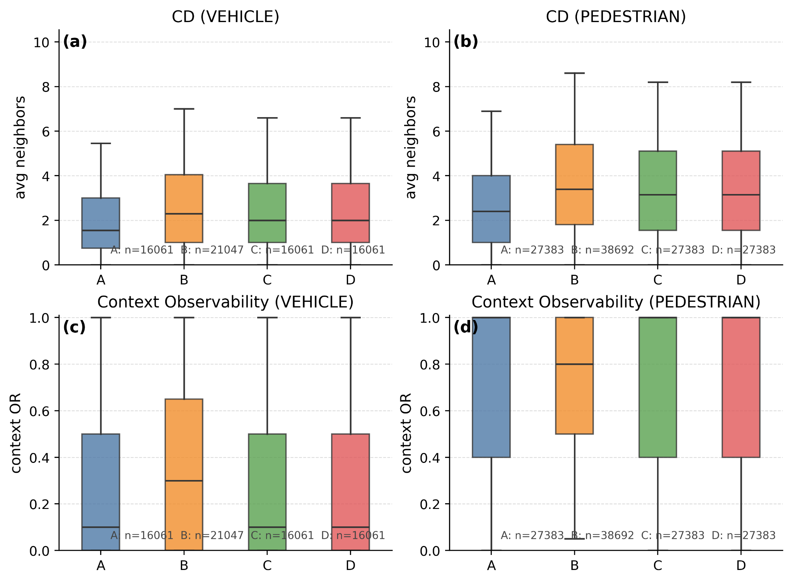
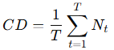
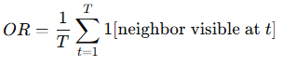
Data Protocols – Data Diagnostics
2. Context density (CD):
T: total number of timesteps in the scene
Nt​: number of neighboring agents within radius r meters from the ego-agent at time t
Measures how many agents are around the ego averagely
B > C≈D > A for both VEH and PED → more neighbors → more potential interactions
3. Context observability (OR):
1[⋅]: indicator function (1 if condition true, else 0)
Measures how continuously an agent is observed during the scene
B pushes PED’ OR toward 1.0, others ≈ 0.4–0.5, lower for VEH → B maximizes exposure length
C/D preserve real gaps

Slide 10
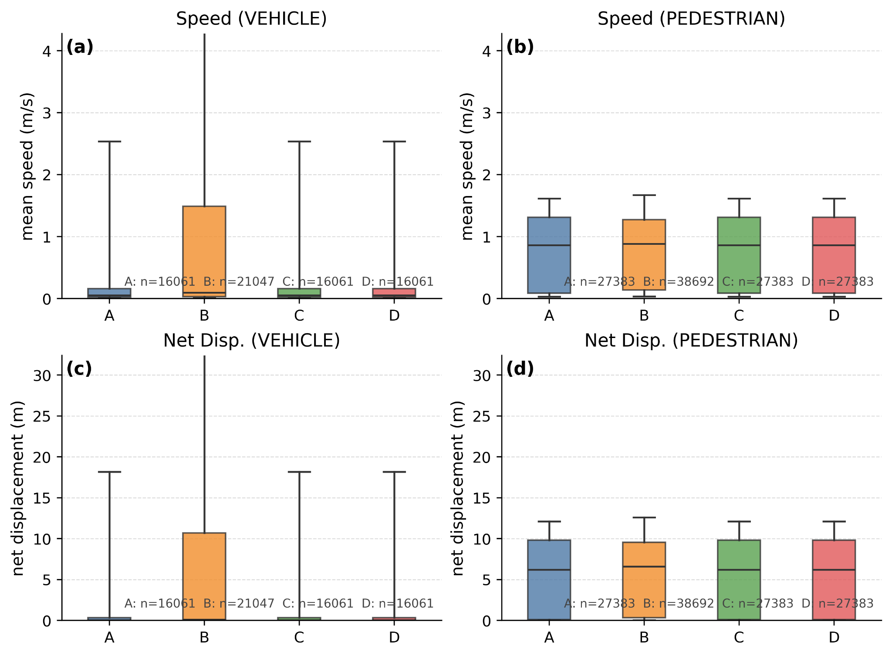
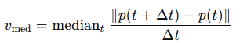
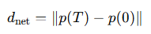
Data Protocols – Data Diagnostics
4. Kinematics (speed / net-disp.):
speed: mean displacement per second
net-disp.: total displacement from start to end
p(t): 2D position of the agent at time t
||⋅||: Euclidean distance
Measures how fast and how far an agent moves.
For vehicles, B has both higher median speed and greater spread, as filling missing data smooths and extends motion trajectories. For pedestrians, the effect is smaller, but still present.

Slide 11
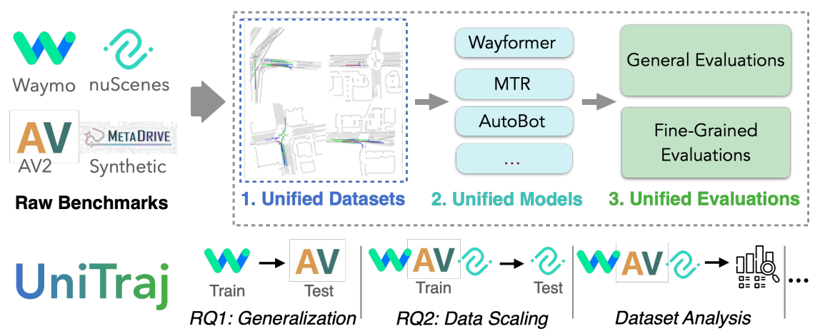
Unitraj Architectures
UniTraj: Unified training & evaluation spine
Single-agent prediction pattern
Model zoo: AutoBot, Wayformer, MTR
Unified data loader and evaluation script
AutoBot (Implicit, set-based interaction)
Encode agents and map as tokens; model interaction implicitly via token attention.
Fixed set of learnable queries attends to the encoded scene to produce multi-modal predictions
Wayformer (Hierarchical, explicit cross-stream fusion)
Hierarchical attention to fuse heterogeneous streams (agent–agent, agent–map, temporal)
Robust to masking, benefits from dense filled context due to feature fusion.
MTR (Joint multi-agent reasoning with coarse-to-fine refinement)
Predict candidate endpoints first, then refine trajectories conditioned on scene context.
Coarse-to-fine pattern helps preserve performance even under partial missingness and dense scenes.

Slide 12
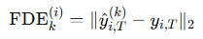
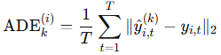
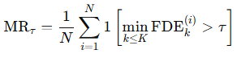
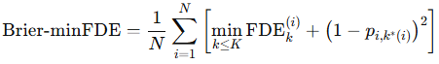
Unitraj Architectures – Metrics
FDE (Final Displacement Error)
ADE (Average Displacement Error)
MR (Miss Rate): Measures how often the best predicted trajectory is still further than τ from the ground truth final points
Brier-minFDE: FDE plus confidence calibration to penalize both final point errors and modes probilities errors
Note:
yi,t∈R2 — ground truth future position of agent i at time t
yi,t^(k)​ — predicted position for the k-th mode
pi,k​ — predicted probability for mode k of agent i
N — number of evaluated agents
T — prediction horizon length (#timesteps)
K — number of predicted modes (top-K)
τ — miss rate threshold (e.g., 2.0 m)
** The trajectory prediction model usually predicts K trajectories for an agent and assigns K confidence scores for ranking. ** We call the predicted K trajectories for every agent K modes

Slide 13
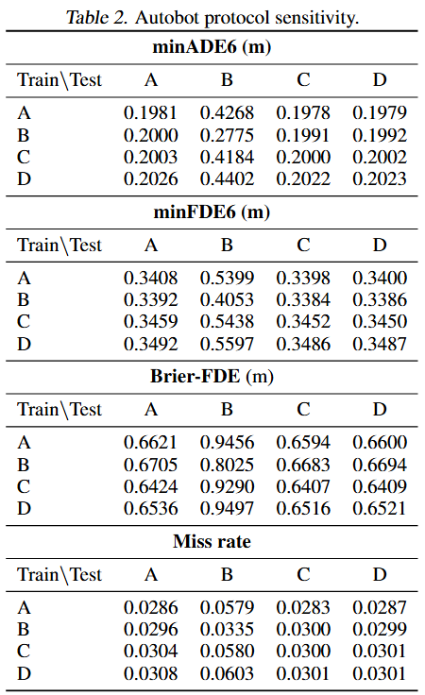
Results – protocol sensitive
Across A/C/D tests:
1. Brier-FDE: C-train is best
Protocol C (Context densified, targets masked)
Contains rich context and pure targets
Preserves missingness semantics.
Probabilities learned on real target frames, so the mode nearest to ground truth also gets higher p* on average → Brier–minFDE ↓
Robuster under most conditions.
**ignore B-test; it’s an optimistic test because targets are partly synthetic

Slide 14
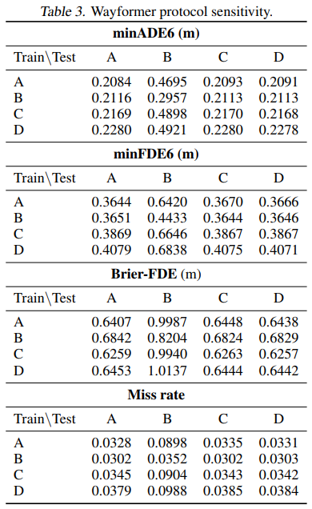
Results – protocol sensitive
Across A/C/D tests:
2. minFDE6: B-train is best
Protocol B (fill-to-full, treat as real)
Interpolation smooths context & targets → stronger long-horizon commitment → minFDE6 ↓.
Treating filled points as ground truth inflates confidence and distorts target geometry → endpoint error can still be small but the probability penalty is large → Brier–minFDE ↑
**ignore B-test; it’s an optimistic test because targets are partly synthetic

Slide 15
Results – protocol sensitive
Across A/C/D tests:
3. minADE6 / Miss rate: A-train is best
Protocol A (strict filter)
Removes incomplete tracks → pure targets, lowest context density, highest stationary → loss sees only real frames, no masks, no imputation noise.
training on stable, long, real sequences reduces per-step error → minADE6 ↓.
more stationary vehicles and shorter net displacements → nudging the model toward conservative endpoints → keeps many samples within the 2 m band → MR ↓
**ignore B-test; it’s an optimistic test because targets are partly synthetic

Slide 16
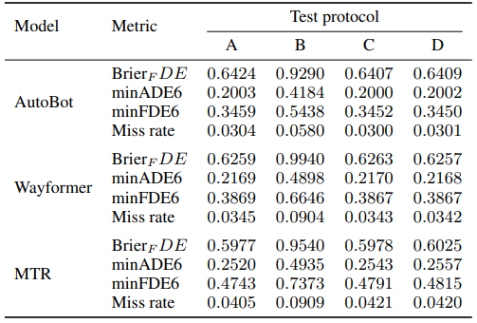
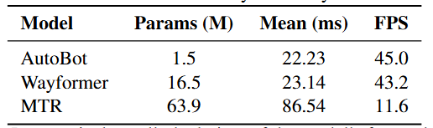
Results – architecture sensitive
Table 4. Across–architecture results on protocols
Across models (Brier-FDE↓, ADE/FDE↓):
Brier-FDE: MTR < Wayformer < Autobot
ADE/FDE/MR: Autobot < Wayformer < MTR
Reasons:
MTR (endpoint-first): Strong endpoint guidance + heavy backbone → higher p∗ → lowest Brier-FDE.
Wayformer (discriminative scoring): Per-mode regressor + explicit score for nearest mode
Autobot (generative best-of-K): Emphasis on min error with weak coupling between geometry and score → probabilities spread or mis-ranked → high Brier-FDE, but strong geometric fit.
Table 5. Efficiency Results

Slide 17
Results – inference
Environment
NVIDIA V100 (16GB), single GPU
Ubuntu 24.04, CUDA 12.8, Driver 570
PyTorch 2.5.0 + Lightning 2.5.2
Key libs: torch-geometric, MetaDrive, Waymo-OD
Inference Efficiency
AutoBot – smallest model, fastest, best real-time
Wayformer – moderate size, still near real-time
MTR – largest model, slowest, better for offline use
Clear trade-off: model size ↑ → latency ↑, FPS ↓
Table 5. Efficiency Results

Slide 18
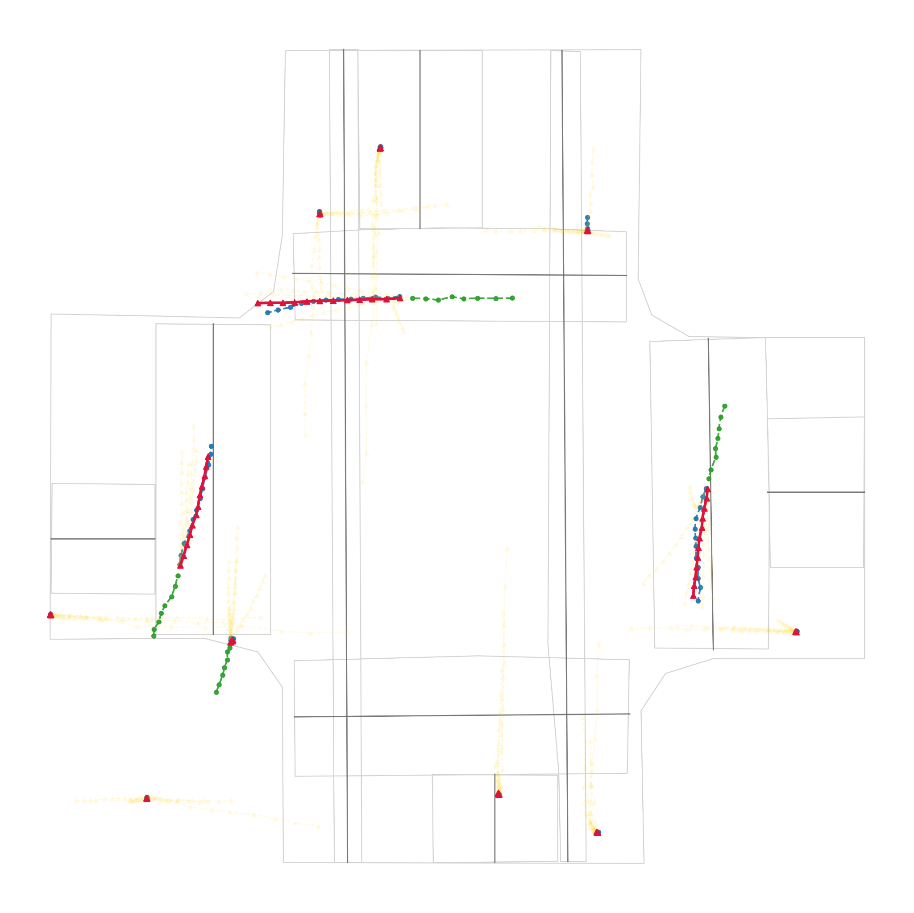
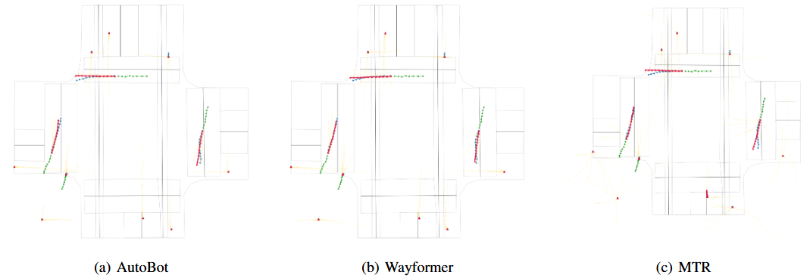
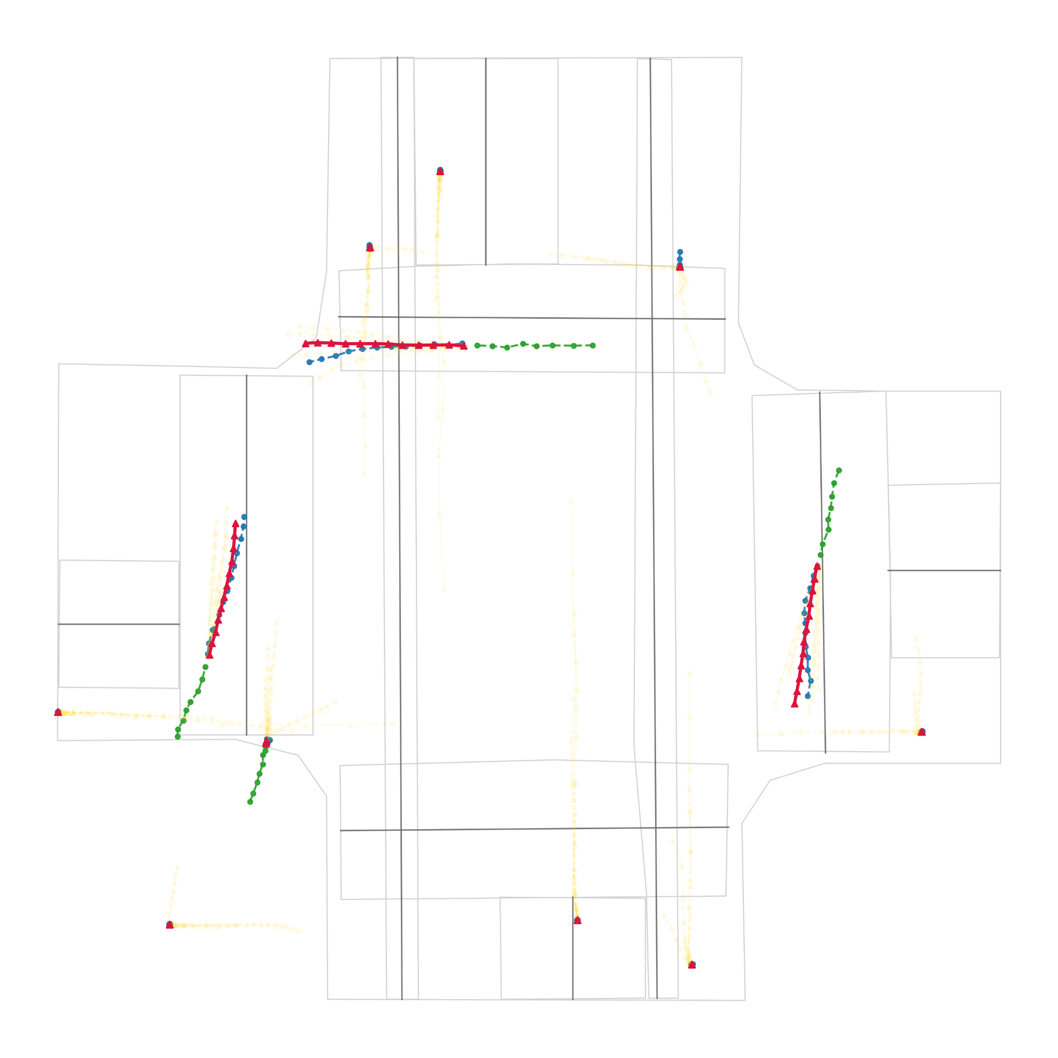
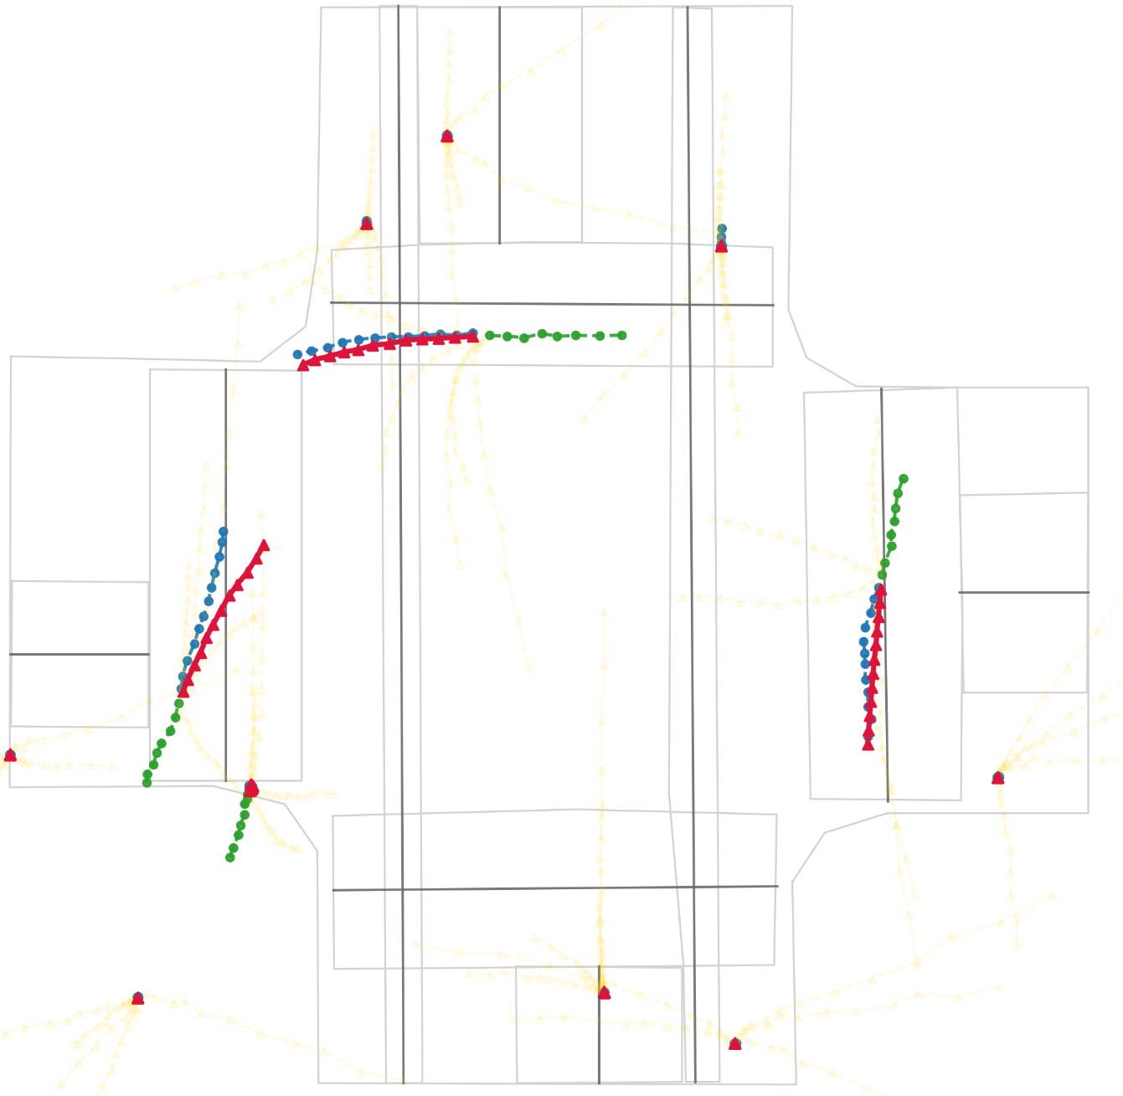
Visualization Results
Qualitative results of the C-protocol trained model on the C test set.
Gray represents the centerline of the map; green represents the observed history; blue represents the future ground truth; red represents the best predicted model; gold represents the remaining five models, with low transparency to minimize interference.

Slide 19
Future work
Scalable evaluation: Include more models and databases for evaluation.
Traffic simulation: Extend UniTraj to closed-loop simulation, and safety-critical evaluation.
Efficient architectures: Investigate lightweight variants of MTR/Wayformer that preserve calibration while approaching AutoBot’s efficiency.

Slide 20
Conclusion
Protocol sensitivity: Training context and target construction significantly shift performance trade-offs.
C-train (context densified, targets masked) → best Brier-FDE (calibration) without sacrificing geometric accuracy.
B-train (fill-to-full, treat as real) → best minFDE but overconfident.
A-train (strict filter) → best minADE / miss rate but weaker long-horizon robustness.
Model sensitivity:
MTR → best calibration (Brier-FDE) via endpoint-first prediction.
Wayformer → second-best calibration, worst geometry (ADE/FDE).
Autobot → best geometry, weakest calibration.
Inference efficiency:
AutoBot achieves highest FPS with smallest parameter count;
Wayformer and MTR trade efficiency for accuracy/calibration, with MTR being the heaviest.

Slide 21
References
Feng, L., Bahari, M., Ben Amor, K. M., Zablocki, ´E., Cord, M., and Alahi, A. Unitraj: A unified framework for scalable vehicle trajectory prediction. In European Conference on Computer Vision (ECCV) Workshops, 2024.arXiv:2403.15098
Girgis, R., Czarnecki, W. M., Pascanu, R., Richemond, P. H., Berner, C., Veli ˇckovi ´c, P., Simonyan, K., and Heess, N. Latent variable sequential set transformers for joint multi-agent motion prediction. In Proceedings of the International Conference on Machine Learning, pp. 3789–3799. PMLR, 2021.
Nayakanti, N., Hong, J., Sapp, B., Ranjbar, M., Anguelov, D., Sminchisescu, C., and Zhou, Y. Wayformer: Motion forecasting via simple and efficient attention networks. In European Conference on Computer Vision, pp. 1–20. Springer, 2022.
Shi, H., Li, X., Ma, Y., Wang, Z., He, C., Gu, X., Li, S., Wang, P., and Yang, R. Mtr: Multi-agent trajectory prediction with relational reasoning. In Proceedings of the IEEE/CVF Conference on Computer Vision and Pattern Recognition, pp. 14834–14843, 2021

Slide 22
Thanks for listening

